Slide 1
Motion Capture and Call of Duty
By: Luke McWilliams

Slide 2
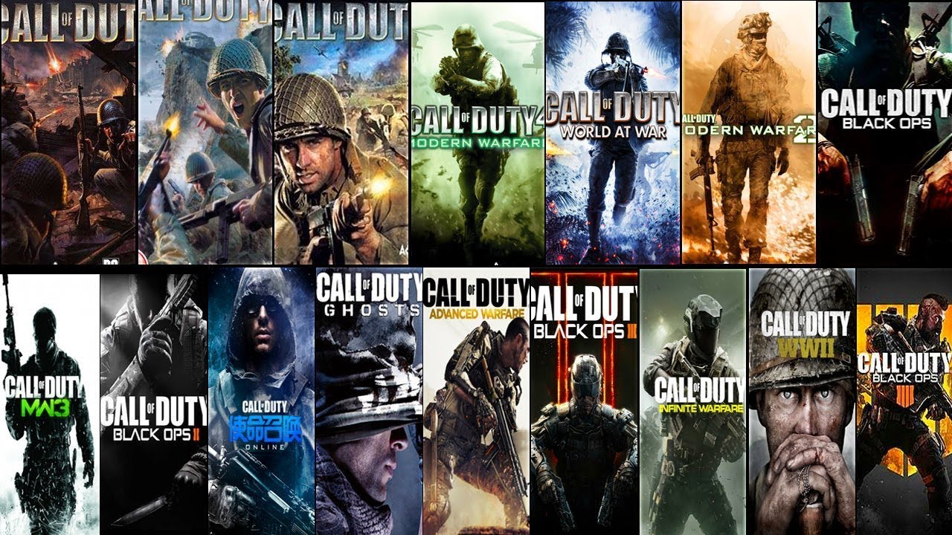
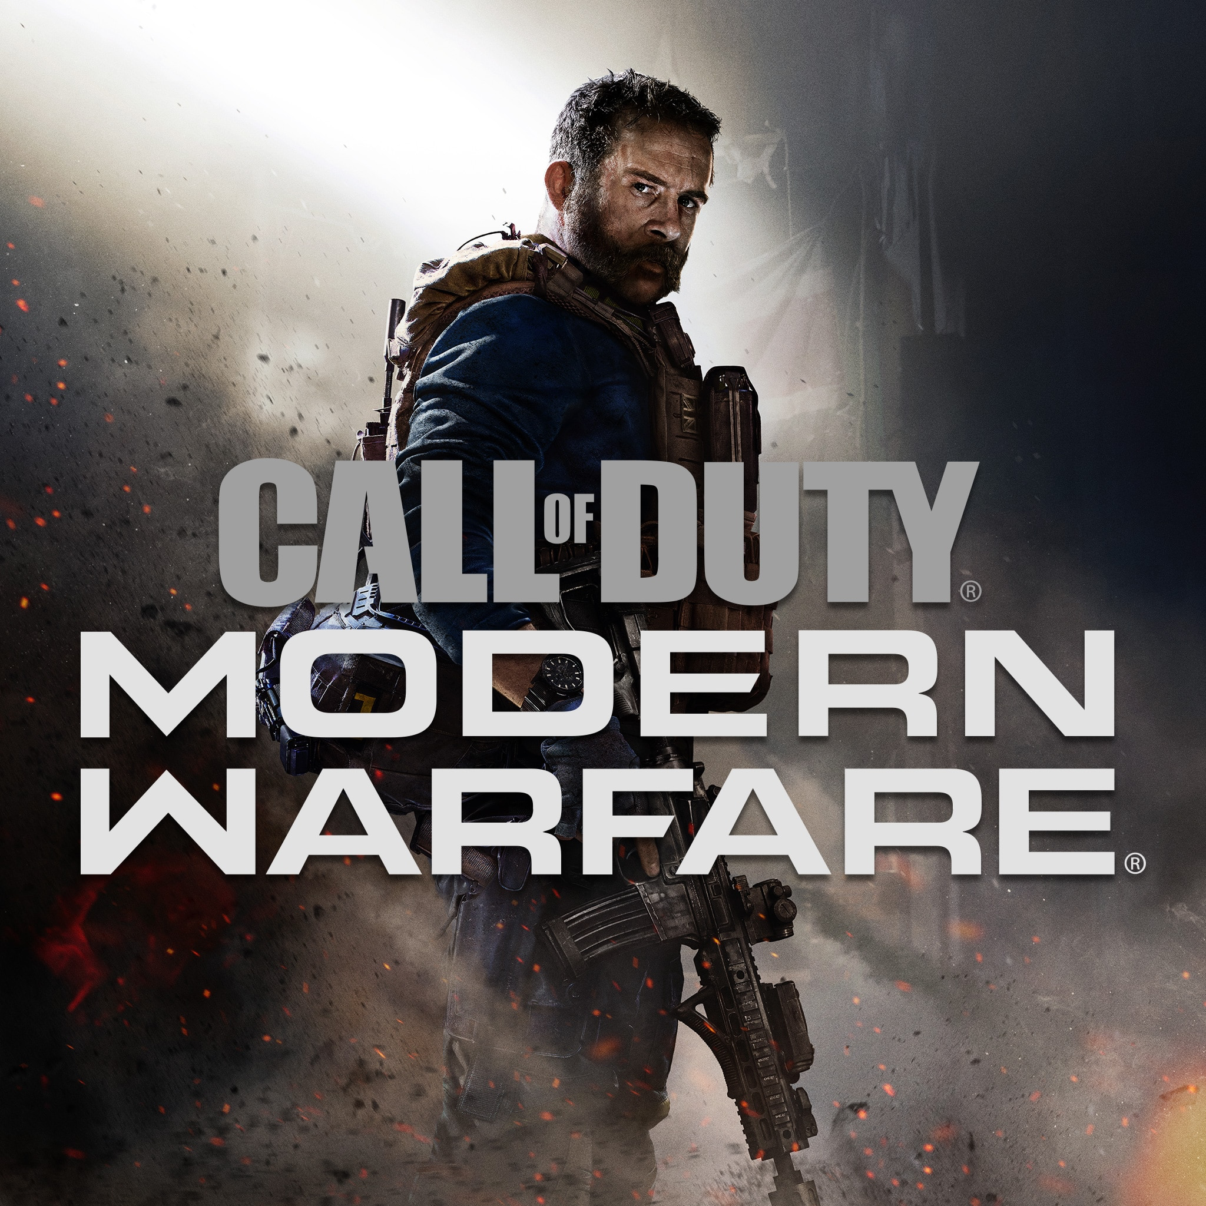


What is Call of Duty?
Call of Duty is a popular First Person Shooter video game franchise
The first game was released back in 2003, Developed by Infinity Ward and Published by Activision, since then every year there has been a new call of duty game all developed by 3 different companies each year (Treyarch, Infinity Ward, and Sledgehammer) and all published by Activision
Every game has a Campaign (story mode) and a multiplayer (Online PVP) and started back in 2008, They added Zombies as a 3rd main mode and has been in almost every cod game since then
COD has been using motion capture for cutscenes in their games for mostly campaign then started doing it for zombies, then multiplayer as time went on.

Slide 3
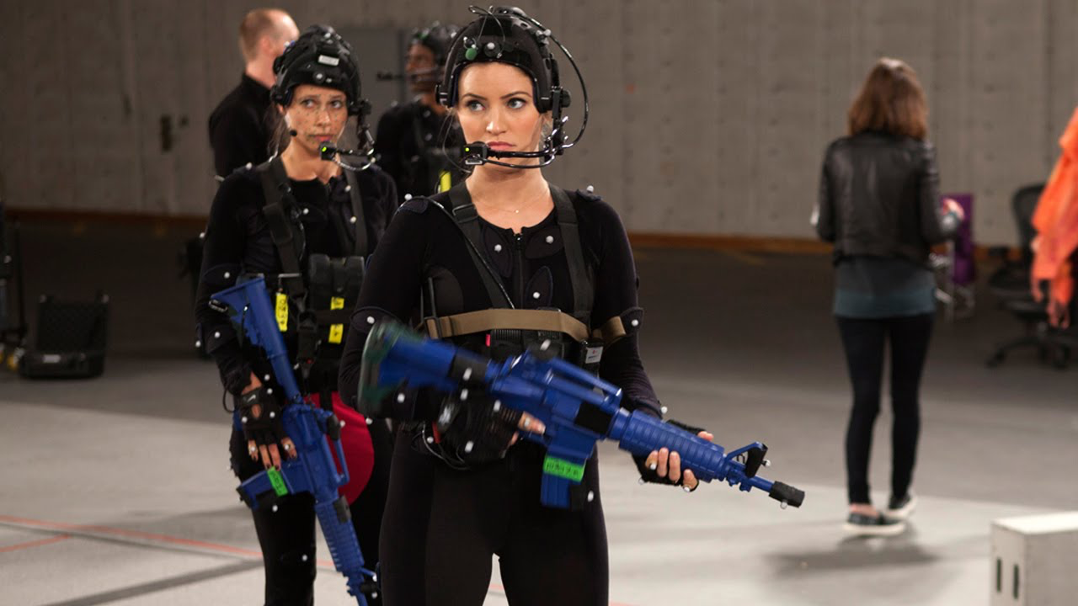
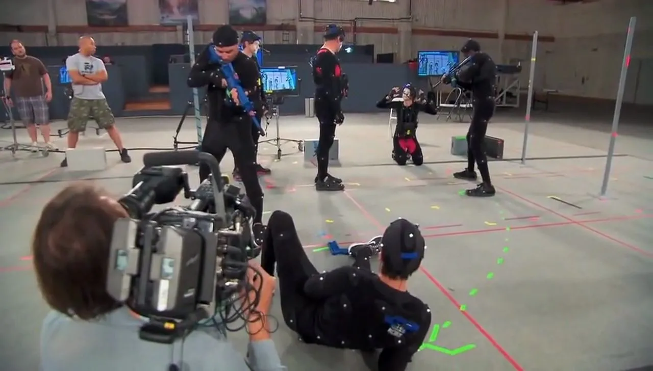
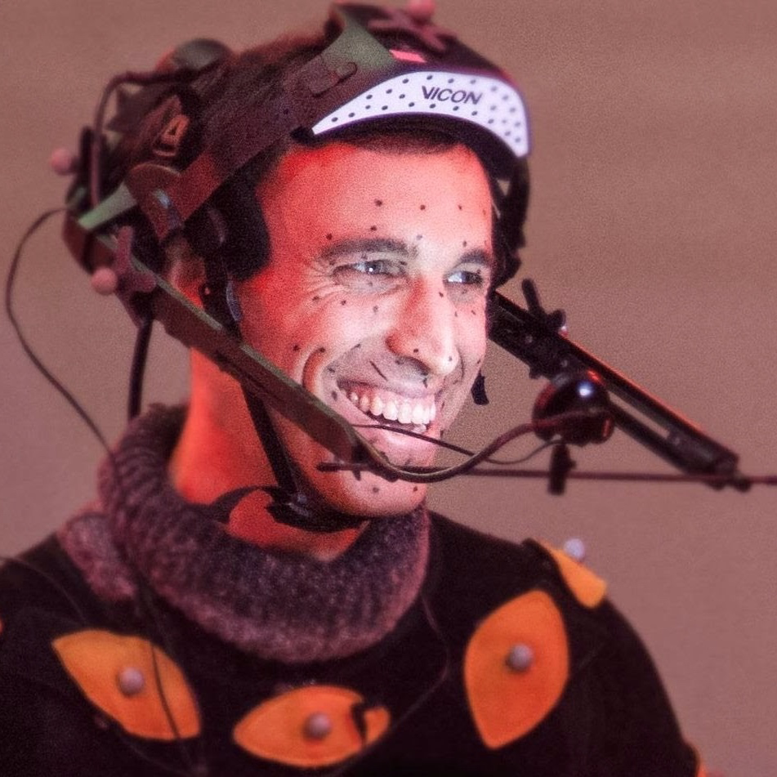
Motion Capture
Motion Capture is Recording real-life movements from actors and converting them into hyper-realistic 3D animations. Although this technique has been used for over 20 years in the film, animation and later the game industry, it has now made a boost in its regular usage
Motion capture uses motion-tracking cameras to capture the movement of an actor or object wearing motion tracking markers. The data is sent to a computer equipped with motion capture software, like Cortex. Cortex takes the motion capture data and creates a virtual skeleton that moves with the actor in real-time. As the actor performs, the director and the production team can see a preliminary animated version of the actor’s performance. Once the desired performance has been achieved, the character can be animated over the skeleton in post-production or real-time

Slide 4
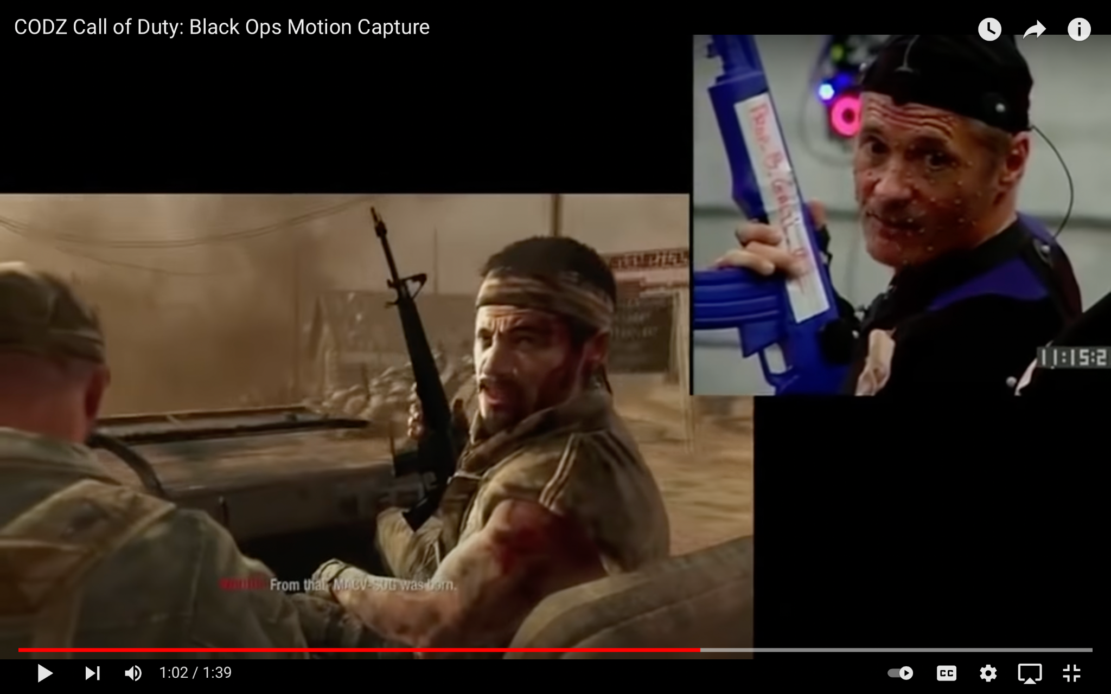

Slide 5
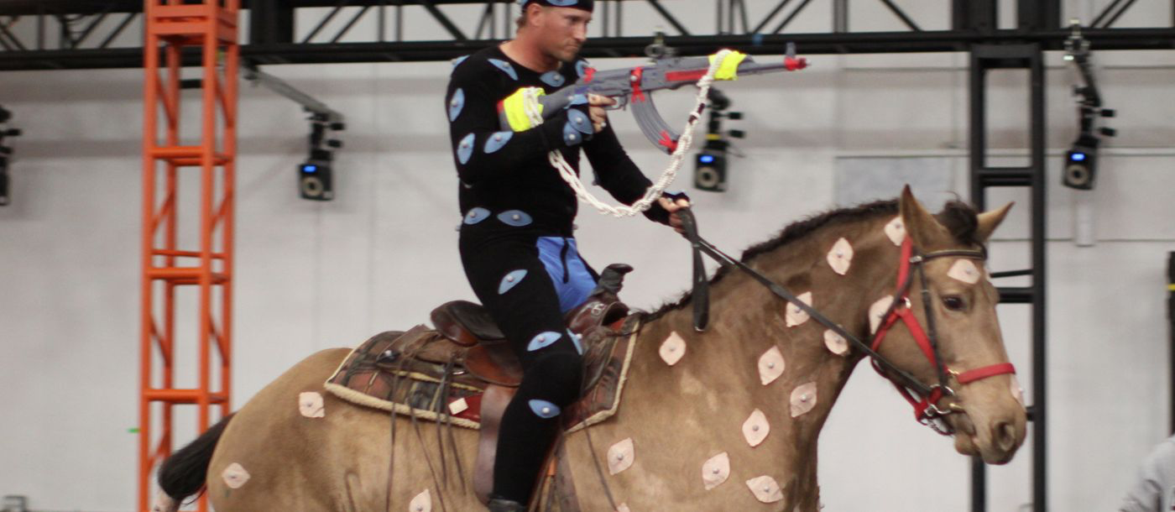

Slide 6
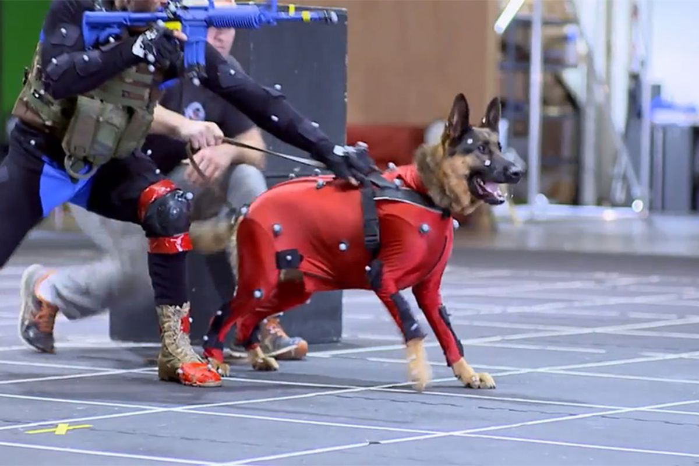

Slide 7
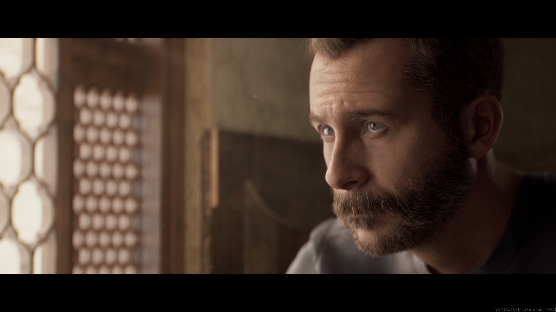

Slide 8
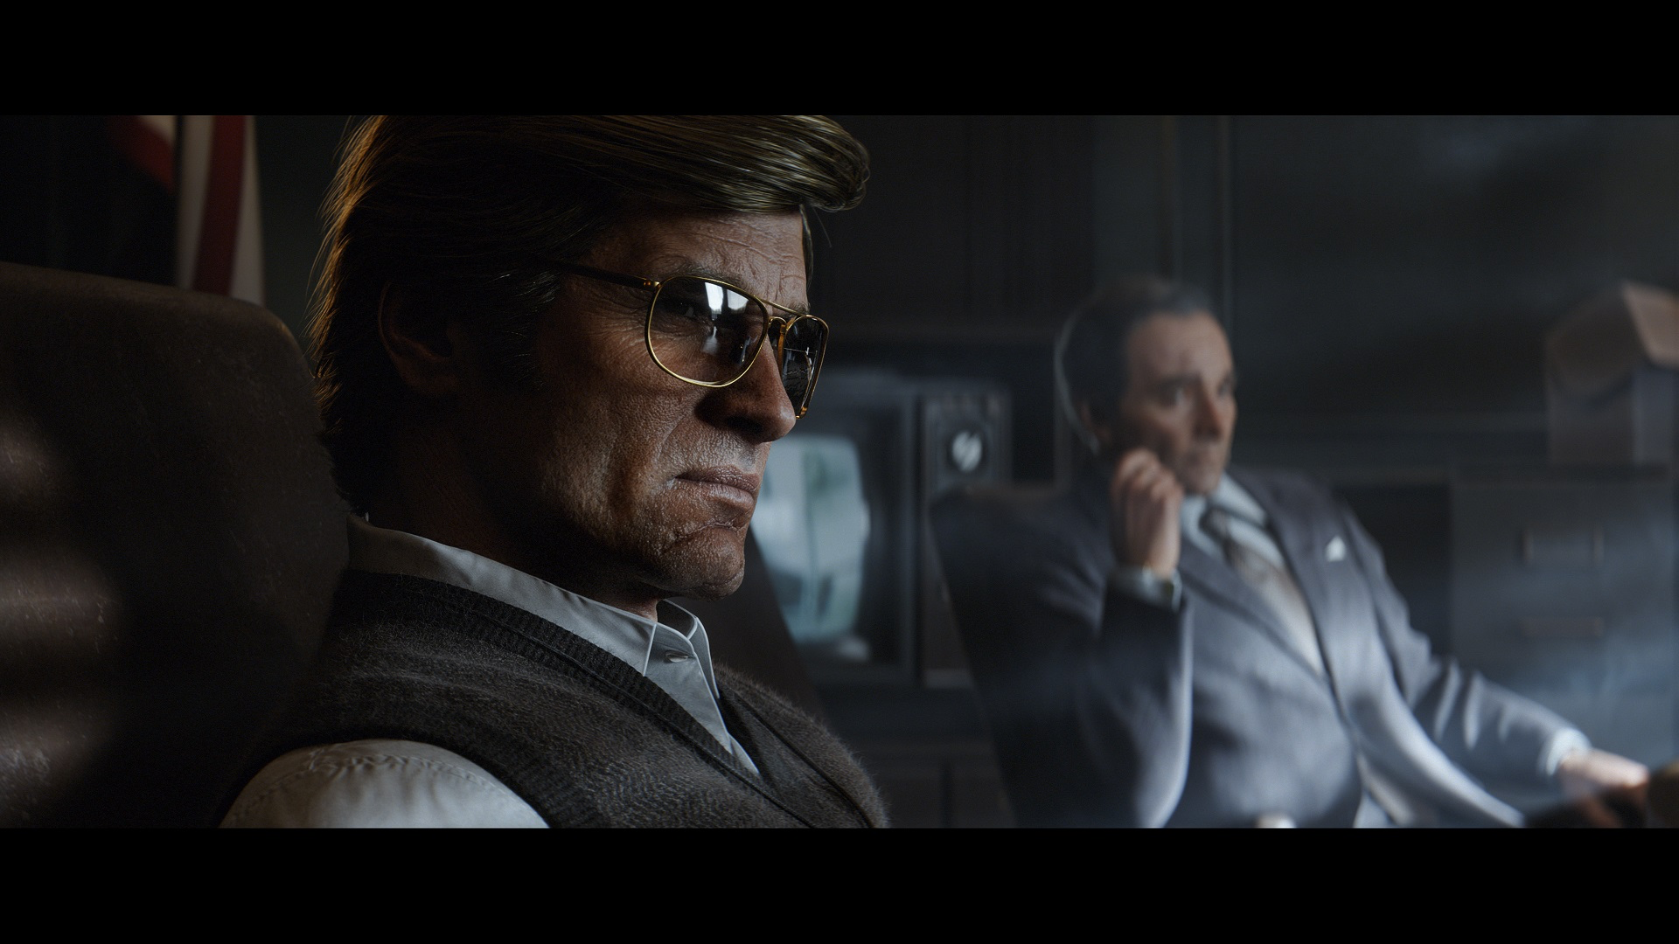

Slide 9
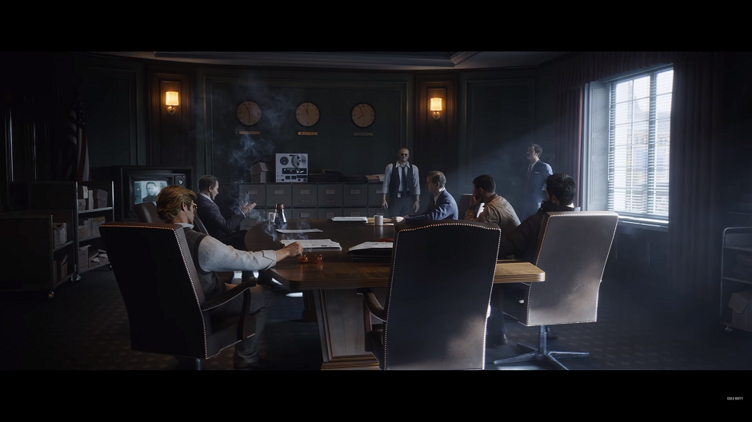

Slide 10
How COVID affected COD’S Motion Capture
Around March 2020, Treyarch, who has been working the next COD title set to release in November, had to shut down their studio (which included their motion cap studio), due to the COVID outbreak. They had only recently had been working all the motion capture stuff for the game but still had a lot to finish when they were forced to shut down. So how did they manage to complete everything without even having access to the studio and resources they needed to do it?

Slide 11
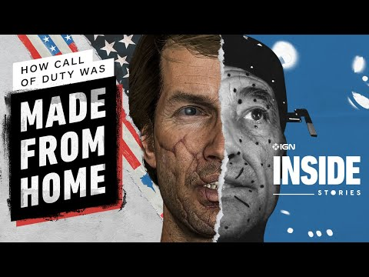
This video briefly explains how they manage to pull it all off

Slide 12
More info
All voice actors/mcap team had to had to make their own setup at home
They did zoom meetings and recorded scenes together on it
There were times when someone's software would glitch or someone had internet problems so they would have to restart the session or reboot their software
The recording process consisted of four sessions per day, every day of the week
They ended up finishing the game around November, just right before they released it.
This shows just how much effort the Treyarch and the other teams put into this COD game
Fun Fact: This game was not supposed to even release that year. One of the developing teams were supposed to release their game that year (Sledgehammer) were told by Activision to step down and wait until this year, 2021, to release their game, and made Treyarch release their game in 2020, a year earlier than expected, so that’s one whole year of development they had to skip.

Slide 13
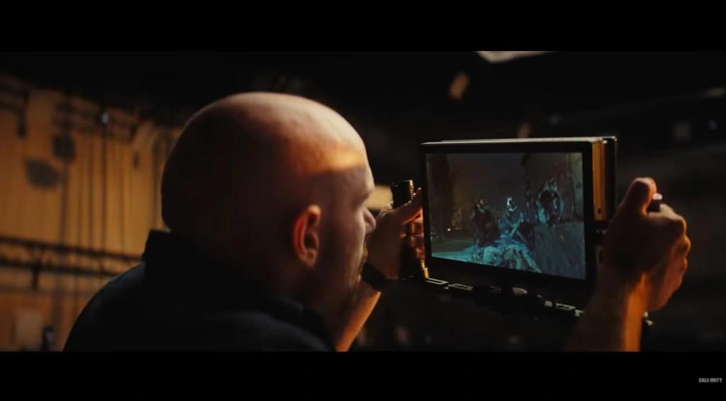
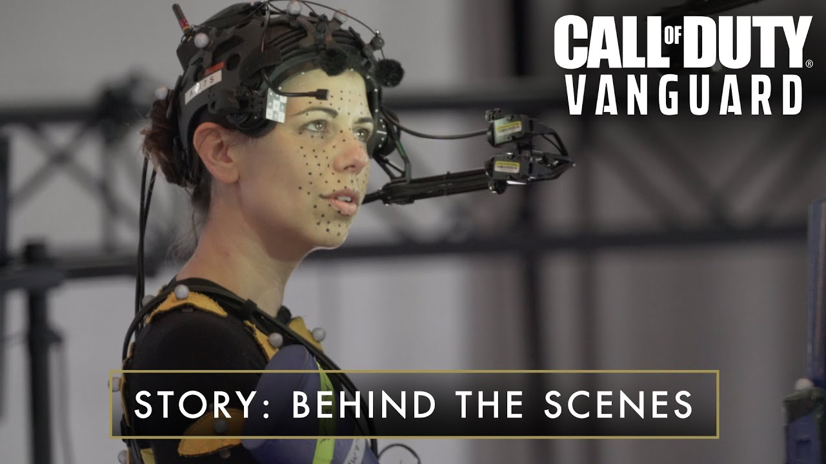
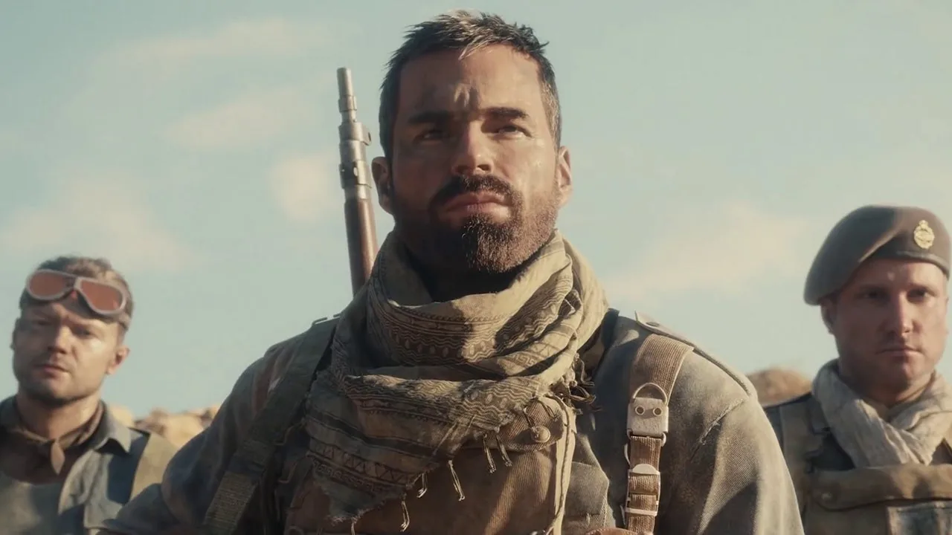
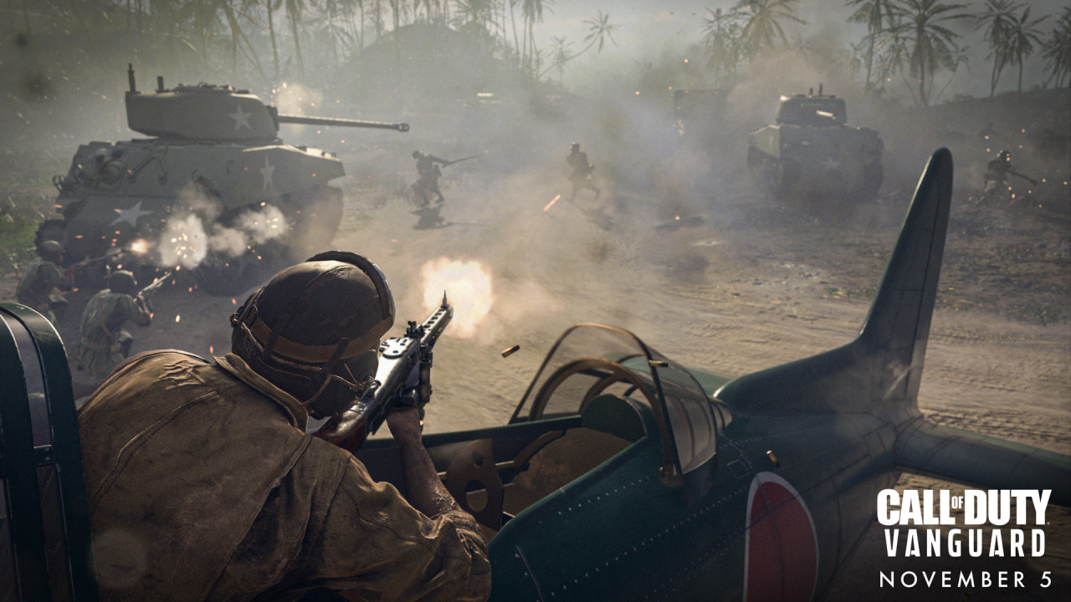
COD and Motion Capture Today
They have started going back to work, meaning they can work in the MCAP Studios again, with COVID restrictions obviously.
Motion Capture will continue to be used in every future COD game

Slide 14
Sources
Slide 2
https://grendelgames.com/getting-started-with-motion-capture/
https://motionanalysis.com/motion-capture-technology-for-video-games/
Slide 12
https://www.washingtonpost.com/video-games/2020/11/11/making-call-of-duty-cold-war/

